Slide 1
AutoSec Agent
Autonomous AI Cybersecurity Defense System
Theme: Agentic AI & Cybersecurity Innovation
Author: Kanishka . A. Sarangdhar | Lovely Professional University

Slide 2
Problem Statement
Cyberattacks are rapidly increasing across global networks.
Traditional security systems rely heavily on manual monitoring.
Security teams cannot analyze millions of logs in real time.
Delayed detection increases risk of data breaches and attacks.
Organizations require intelligent automated threat detection.

Slide 3
Project Objective
Build an AI-powered cybersecurity defense system.
Detect cyber threats automatically using machine learning.
Analyze network traffic patterns.
Recommend security mitigation actions using Agentic AI.
Reduce human workload and improve security response speed.

Slide 4
What is Agentic AI?
Agentic AI systems operate autonomously.
Observe: Collect network traffic and system logs.
Reason: Analyze data using machine learning models.
Plan: Determine the best security response.
Act: Execute mitigation or alert actions.

Slide 5
Proposed Solution: AutoSec Agent
AutoSec Agent monitors network traffic continuously.
Detects anomalies using machine learning models.
Classifies network attacks automatically.
Agentic AI recommends mitigation actions.
Provides intelligent autonomous cybersecurity defense.

Slide 6
System Architecture
Network Logs Data Preprocessing Feature Engineering
Agentic AI Threat Detection Machine Learning Model Decision Engine
Autonomous Response

Slide 7
Dataset: NSL-KDD
Benchmark dataset for intrusion detection research.
Contains labeled network traffic records.
Attack Categories:
DoS Attacks (neptune, smurf)
Probe Attacks (satan, ipsweep)
R2L and U2R attacks.

Slide 8
Technologies Used
Python Programming Language
Scikit-learn Machine Learning Library
Pandas for data processing
Matplotlib and Seaborn for visualization
Agentic AI logic for automated decisions.

Slide 9
Machine Learning Model
Random Forest Classifier used for intrusion detection.
Handles large feature sets effectively.
Robust to noisy data.
Classifies normal and malicious traffic patterns.

Slide 10
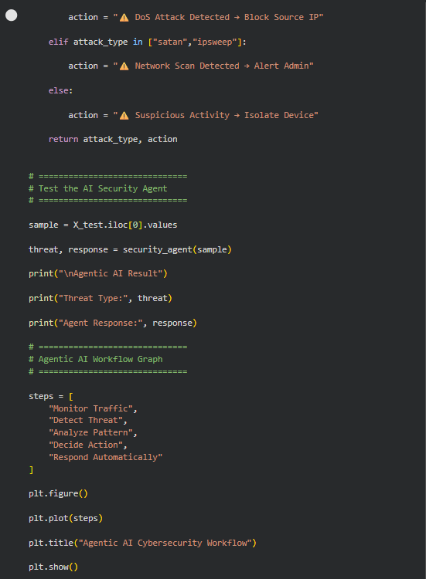
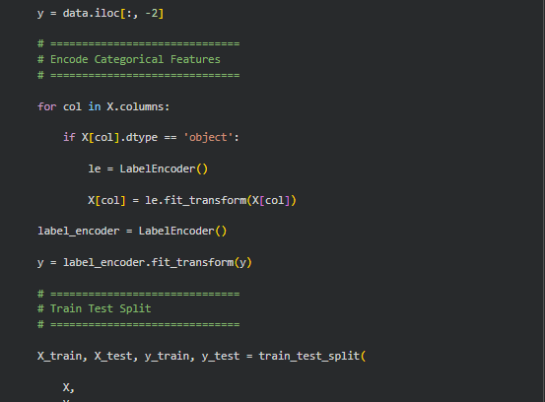
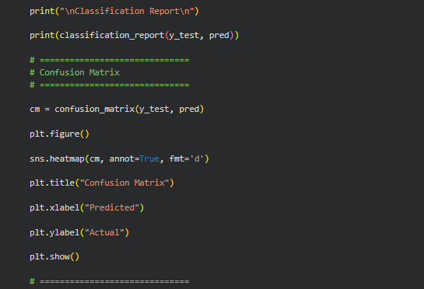
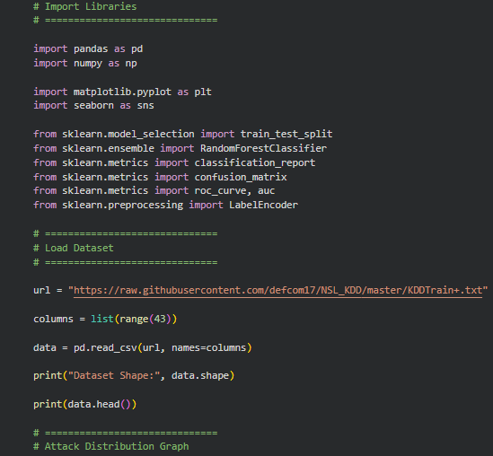
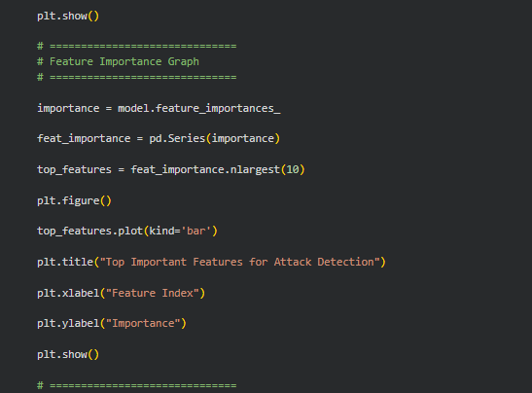
Model Training Code
model = RandomForestClassifier(n_estimators=100)
model.fit(X_train, y_train)
pred = model.predict(X_test)

Slide 11
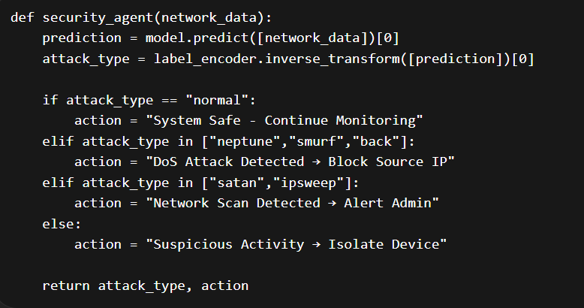
Agentic AI Decision Engine
AI agent evaluates predicted attack type.
Normal traffic ? Continue monitoring.
DoS attack ? Block source IP.
Network scan ? Alert administrator.
Suspicious behavior ? Isolate device.

Slide 12
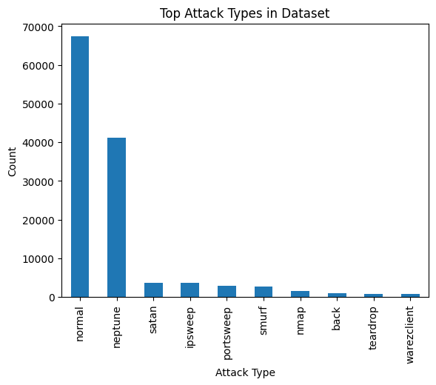
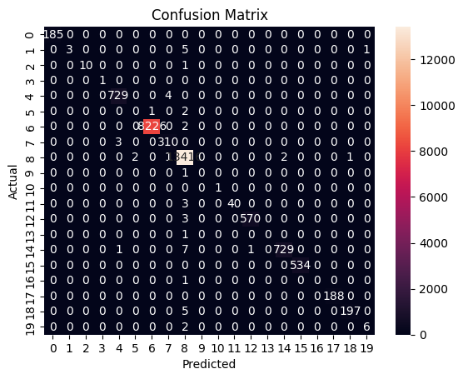
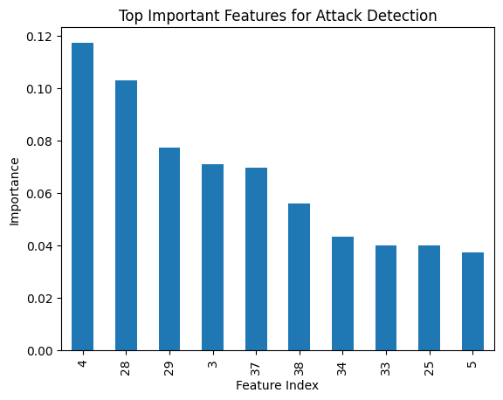
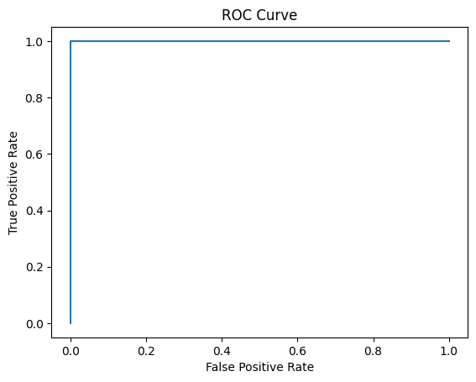
Visualization Results
Attack Distribution Graph.
Confusion Matrix.
ROC Curve.
Feature Importance Analysis.

Slide 13
Model Performance
precision recall f1-score support
0 1.00 1.00 1.00 185
1 1.00 0.33 0.50 9
3 1.00 0.91 0.95 11
4 1.00 1.00 1.00 1
5 0.99 0.99 0.99 733
6 0.00 0.00 0.00 3
9 1.00 1.00 1.00 8228
10 0.98 0.99 0.99 313
11 1.00 1.00 1.00 13422
12 0.00 0.00 0.00 1
13 1.00 1.00 1.00 1
14 1.00 0.93 0.96 43
15 1.00 0.99 1.00 573
16 0.00 0.00 0.00 1
17 1.00 0.99 0.99 738
18 1.00 1.00 1.00 534
19 0.00 0.00 0.00 1
20 1.00 1.00 1.00 188
21 0.99 0.98 0.98 202
22 0.86 0.75 0.80 8
accuracy 1.00 25195
macro avg 0.79 0.74 0.76 25195
weighted avg 1.00 1.00 1.00 25195
Model Accuracy ˜ 99–100%
High precision and recall for major attack categories.
Low false positive rate.
Effective threat detection capability.

Slide 14
AI Cybersecurity Workflow
Monitor Network Traffic Detect Threat Analyze Pattern
Respond Automatically Decide Action

Slide 15
Advantages
Autonomous threat detection.
Faster incident response.
Reduced human workload.
Scalable cybersecurity defense.

Slide 16
Future Improvements
Real-time cybersecurity dashboard.
Multi-agent AI defense architecture.
Integration with firewall systems.
Generative AI for threat explanations.

Slide 17
Conclusion
AutoSec Agent demonstrates autonomous cybersecurity defense.
Machine learning enables accurate threat detection.
Agentic AI enables intelligent security decisions.
Future cybersecurity systems will be AI-driven.

Slide 18
Thank You
Questions? | Contact:kanishkasarngdhar44@gmail.com

